Slide 1
Elucidation of Gut Microbiome Response to Dietary Fiber Types Using MBRAs
Outstanding Questions:
Which types of fibers result in favorable/unfavorable shifts that are functionally relevant?
What are the ecological and functional consequences of fiber fermentation on host health?
INPUTS
OUTPUTS
In Vitro
In Vivo
FIBER
Soluble
Insoluble
Combination
Microbiome
Composition
Stability
Resilience
Relationships
Organoids
Microarray
Methylation
Cytokines
miRNAs
GF Animals
WT/CRC
Adaptive KO
Innate KO
Human Stool
“Healthy”
Colon Cancer
Metabolome
Global
Targeted:
SCFAs
AAs
PBMCs
Microarray
Cytokines
Drugs
Oxaliplatin
5 FU
Antibiotics
OMVs
Protein
Small RNAs
DNA
metabolites

Slide 2
Three Phase Strategy for Developing Precision Medicine Prebiotics
INPUTS
OUTPUTS
INPUTS
In Vitro
INPUTS
In Vivo
FIBER
Soluble
Insoluble
Combination
Microbiome
Composition
Stability
Resilience
Relationships
FIBER
Soluble
Insoluble
Combination
Organoids
Microarray
Methylation
Cytokines
miRNAs
FIBER
Soluble
Insoluble
Combination
GF Animals
WT/Cancer
Adaptive KO
Innate KO
Human Stool
“Healthy”
Metabolome
Global &
Targeted:
SCFAs
Human Stool
“Healthy”
Colon Cancer
Immune System
Microarray
Cytokines
Human Stool
“Healthy”
Colon Cancer
Clinical Trials
Drugs
Antibiotics
Metabolic Modeling
Microbiome
metabolites
Drugs
5 FU
Oxaliplatin
Metabolic Modeling
Microbiome
metabolites
Drugs
5 FU
Oxaliplatin
PHASE I
PHASE II
PHASE III

Slide 3
INPUTS
MBRA
OUTPUTS
FIBER
Inulin
Resistant starch
Combination
Microbiome
Composition
Stability
Resilience
Resistance
Human Stool
“Healthy” donors
Metabolites
Global profile
Targeted:
SCFAs

Slide 4
Outstanding Questions:
Which types of fibers result in favorable/unfavorable shifts that are functionally relevant?
Which types of fibers prevent pathogen colonization – c. diff, ETBF, E. coli pks, MRSA
Which types of fibers prevent development of biofilm formation
Which types of fibers results in the most diversity or highest amount of competition/stability
Which types of fibers create the resiliency to stressors – pH, temperature, O2 (e.g. what is the buffering capability)
What are the ecological and functional consequences of fiber fermentation on host health?
How do different fibers alter the microbial community to protect from colon cancer development
How do different fibers alter the microbial community to modulate stem cells/CSCs
Specific Aims:
Determine model community changes in composition and metabolism after exposure to inulin or resistant starch
Measure alpha and beta diversity after inulin or resistant starch exposure in three model stool communities
Determine changes in short chain fatty acid and metabolism after inulin or resistant starch exposure in three model stool communities
Measure ability to resist pathogen colonization by c. diff, MRSA or enterotoxic B. fragilis in fiber-exposed stool community
Quantify ability to recover from antibiotic challenge in fiber-exposed stool community

Slide 5
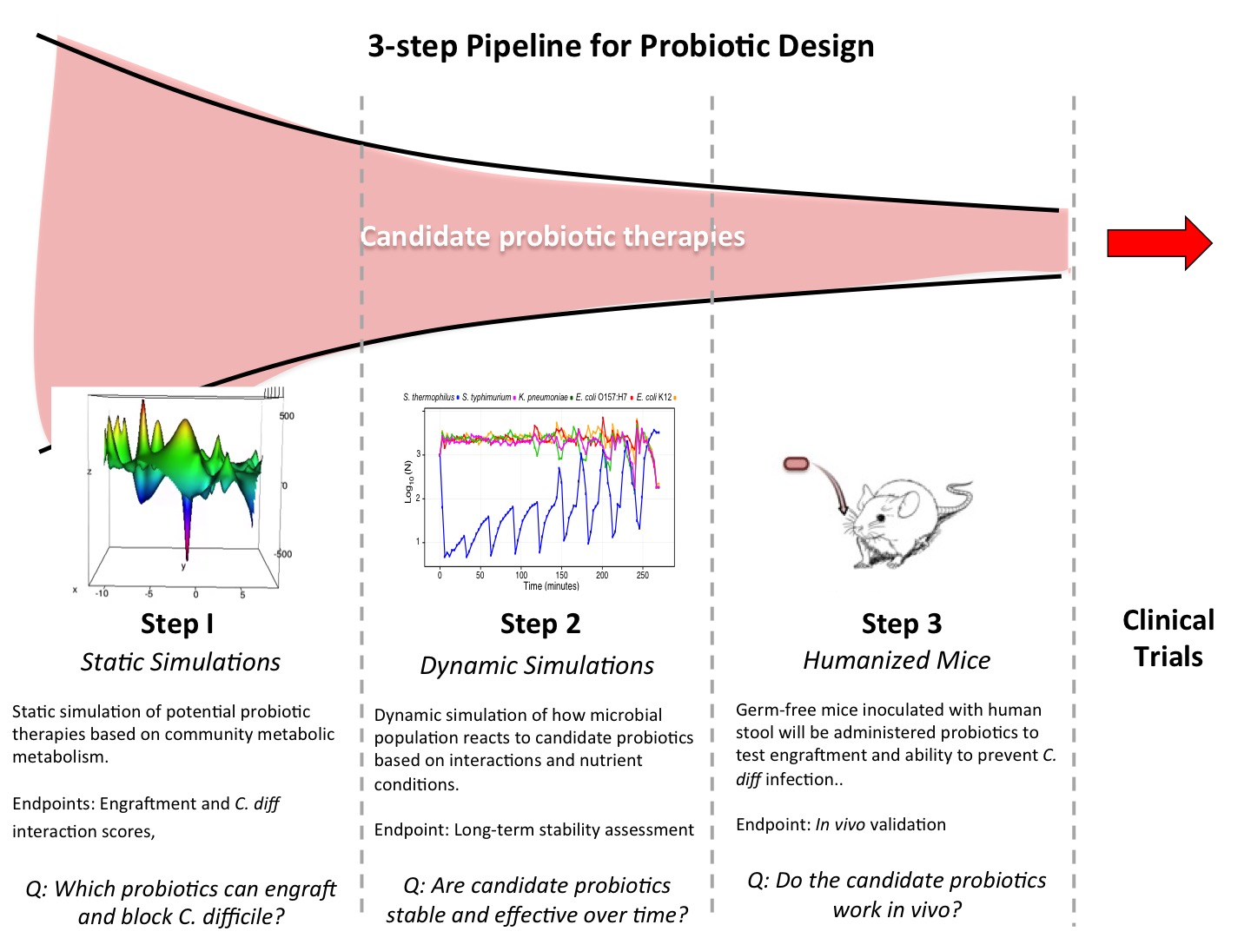

Slide 6
Fiber-Microbiome Modeling
-Microbial community
response to dietary prebiotic
fibers
-Resistance to ETBF or C.
difficile infection
-Model nutrient-metabolite
interactions
Q: Which dietary fibers prevent pathogen invasion?
Fiber Conditioned Microbiome Response
-“Healthy” vs colon cancer stool
community response to fibers
-Fiber conditioned microbiome response to immune system
Q: Which dietary fibers promote a favorable immune response in healthy/cancer stool communities?
Candidate Fiber Testing
-Germ free mice humanized with
fiber-conditioned microbiome
-Fiber conditioned community
effect on host tumor response
-Fiber conditioned microbiome
response to cancer therapy
Q: Does the fiber conditioned microbiome improve response to cancer therapy?

Slide 7
Fiber-Microbiome Modeling
-Microbial community
response to dietary prebiotic
fibers
-Resistance to ETBF or C.
difficile infection
-Model nutrient-metabolite
interactions
Q: Which host/environment signals → OMV/sRNA cargo?
Fiber Conditioned Microbiome Response
-“Healthy” vs colon cancer stool
community response to fibers
-Fiber conditioned microbiome response to immune system
Q: Which dietary fibers promote a favorable immune response in healthy/cancer stool communities?
Candidate Fiber Testing
-Germ free mice humanized with
fiber-conditioned microbiome
-Fiber conditioned community
effect on host tumor response
-Fiber conditioned microbiome
response to cancer therapy
Q: Does the fiber conditioned microbiome improve response to cancer therapy?

Slide 8
INPUTS
TOOLS
OUTPUTS
INPUTS
TOOLS
OUTPUTS
Host
-Nutrients
-pH/O2
-Mucin
-AMPs
Model Gut
OMVs
Composition
Structure
Quantity
Host
-Diet
-Human stool
(healthy/IBS)
GF Animals
WT/IBS
Adaptive KO
Innate KO
OMVs
Composition
Structure
Quantity
Organoids
Environment
-microbial community
-metabolites
-phage/virus
sRNA species
Sequence
Expression
Composition
Environment
Stress
Engineered OMVs
sRNA species
Sequence
Expression
Composition
Click Chemistry
Click Chemistry
Drugs
Antibiotics
Inflammation
Microarray
Cytokines
miRNAs
Drugs
Antibiotics
Inflammation
-Microarray
-Cytokines
-Immune cell composition
Q#1-2/PHASE I
Years 1-3
Q#2-3/PHASE II
Years 3-5
Strategy for Developing Inflammation-Controlling OMV Therapeutics

Slide 9
Notes:
https://www.sciencedirect.com/science/article/pii/S1742706119302764

Slide 10
